Slide 1
ML Ops Tools: ML ﬂow and Hugging Face
17/04/2024

Slide 2
Course Overview
This course covers two of the most popular open-source platforms for MLOps (Machine Learning Operations): ML flow and Hugging Face. We’ll go through the foundations on what it takes to get started in these platforms with basic model and dataset operations. You will start with ML flow using projects and models with its powerful tracking system and you will learn how to interact with these registered models from ML flow with full lifecycle examples. Then, you will explore Hugging Face repositories so that you can store datasets, models, and create live interactive demos.

Slide 3
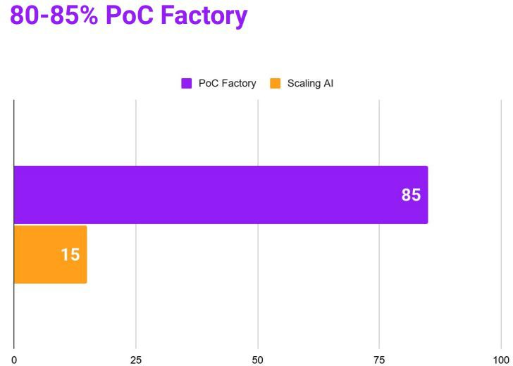
The Proof of Concept Factory
Most companies...
… conduct AI experiments and pilots but achieve a low scaling success rate
… have signiﬁcant under investment, yielding low returns

Slide 4
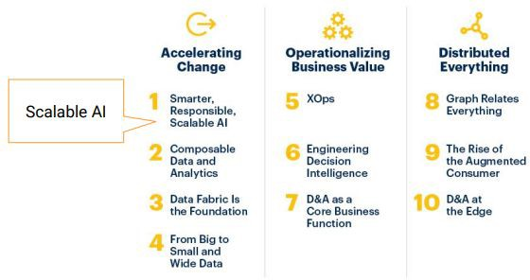

Gartner Top 10 Data and Analytics Trends
gartner.com/SmarterWithGartner

Slide 5
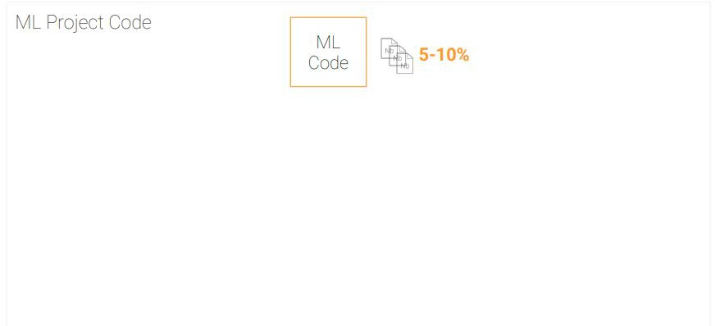
The problem with scaling AI
ML code is only a fraction of a production-ready ML project code

Slide 6
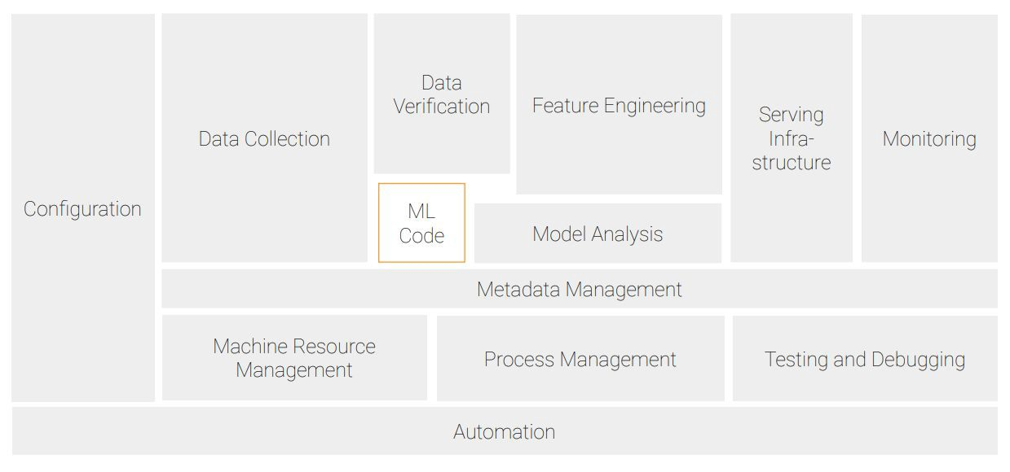
Hidden technical debt in machine learning systems

Slide 7
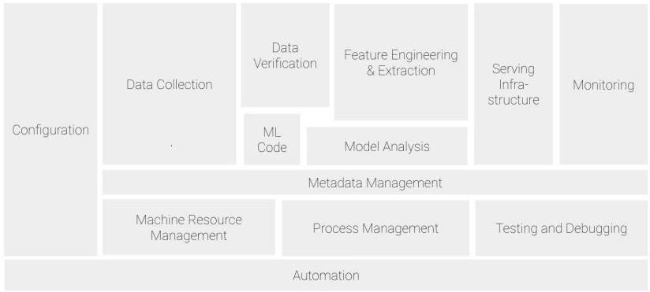
Machine learning operations (MLOps)
ML Engineering culture and practice that aims at unifying ML System development (Dev) and ML system operations (Ops)
Tools and principles to support workﬂow standardization and automation through the ML system lifecycle (e.g. with pipelines)

Slide 8
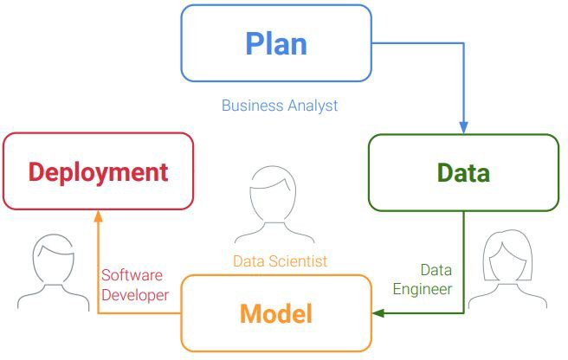
Machine learning lifecycle
Lifecycle
of an ML System
Plan | Data | Model | Deployment

Slide 9
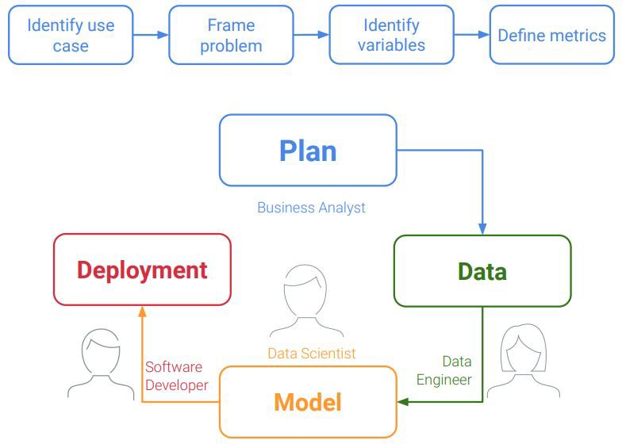
Lifecycle
of an ML System Plan | Data | Model | Deployment

Slide 10
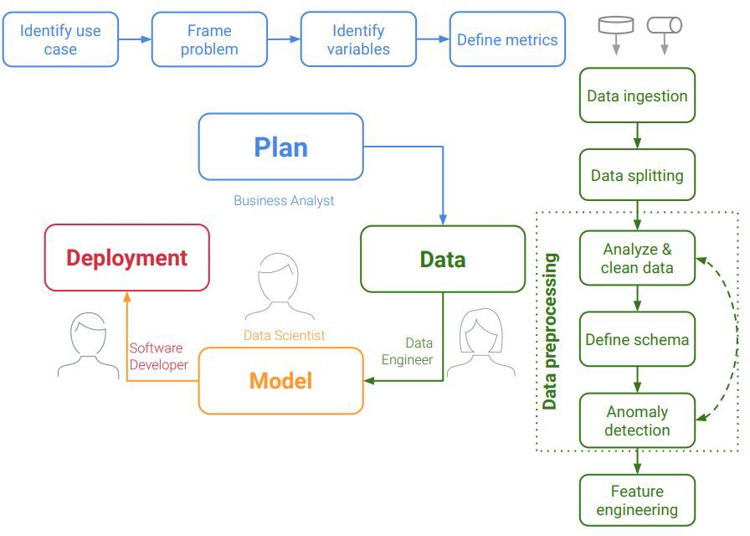
Lifecycle
of an ML System Plan | Data | Model | Deployment

Slide 11
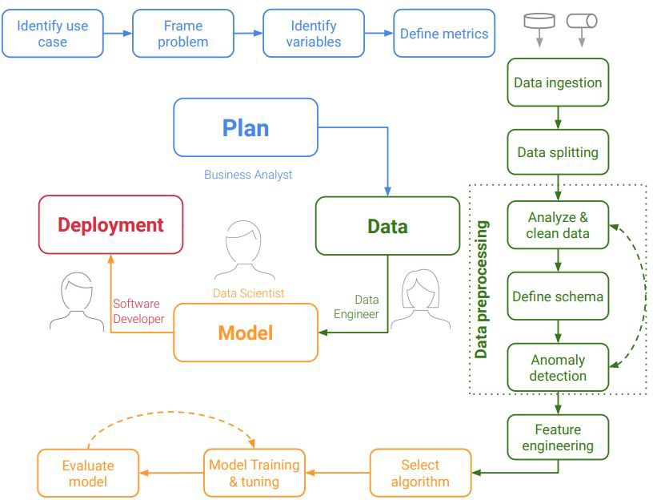
Lifecycle
of an ML System Plan | Data | Model | Deployment

Slide 12
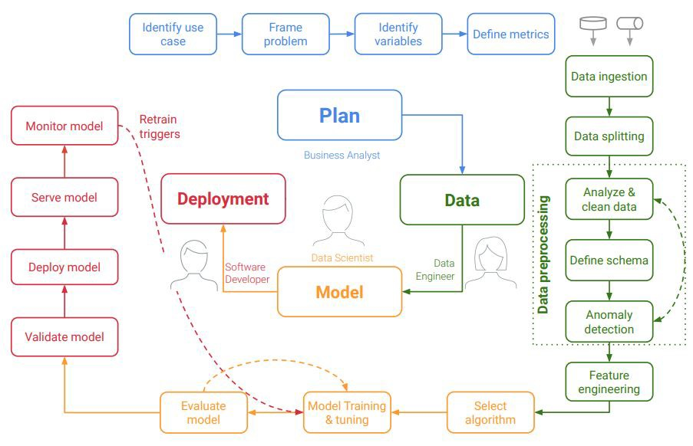
Lifecycle
of an ML System Plan | Data | Model | Deployment

Slide 13
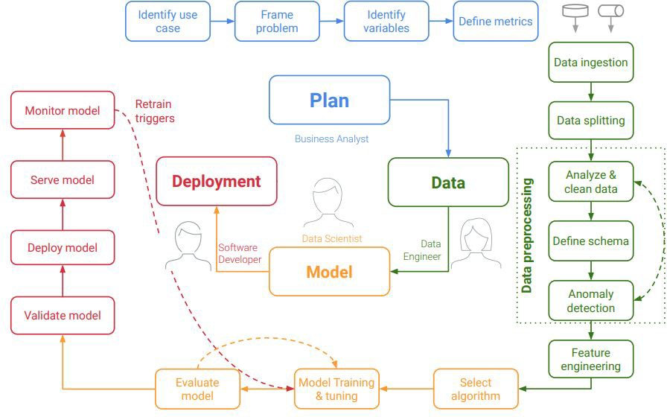
Lifecycle
of an ML System Plan | Data | Model | Deployment
Common issues which lead to a PoC to production gap
Lack of reuse and duplication
Inconsistency (data, code, models)
Manual and slow transition from PoC to production

Slide 14

Lifecycle
of an ML System Plan | Data | Model | Deployment
MLOps components

Slide 15
Q&A
Questions and answers

Slide 16

An open platform for the machine learning lifecycle
• Python Library; runs locally and on the cloud
• Built-in UI for experiment visualization
• Logging integrations for major frameworks: scikit-learn,
PyTorch, TF,..
https://github.com/mlflow

Slide 17
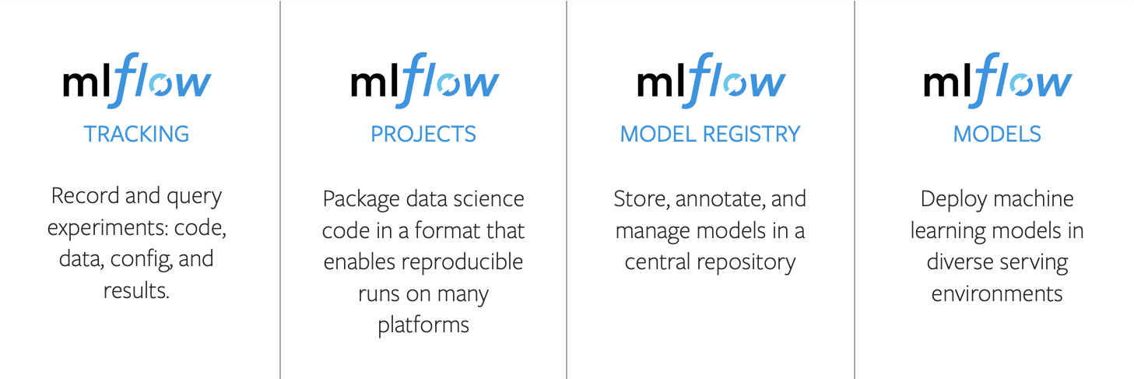

Slide 18
Getting Started with MLflow
Install with pip install mlflow
• Find detailed tutorials at mlflow.org
• Repo: https://github.com/mlflow
• Main contributor and maintainer:
• Managed MLflow services offered by Databricks and Azure
ML

Slide 19
MLflow Components
Experiment tracking
Hyper Parameters: key-value inputs
• Metrics: numeric values (i.e. perf metrics)
• Artifacts: files, including data and models
• Source: training code any additional information

Slide 20
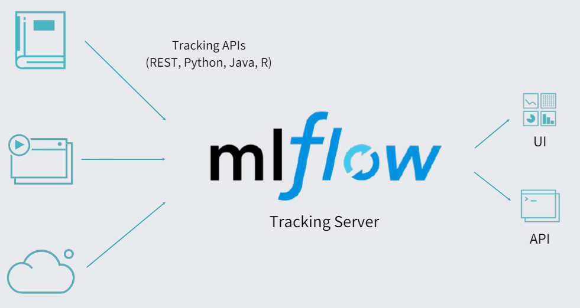

Slide 21
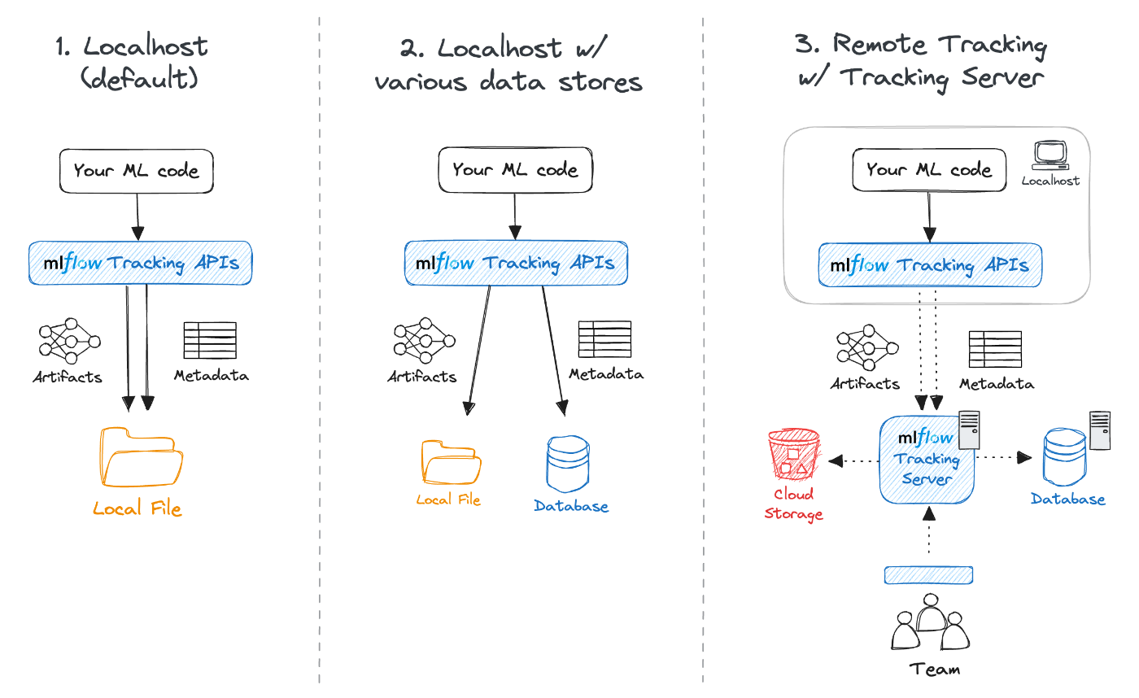
ML Flow - Tracking

Slide 22
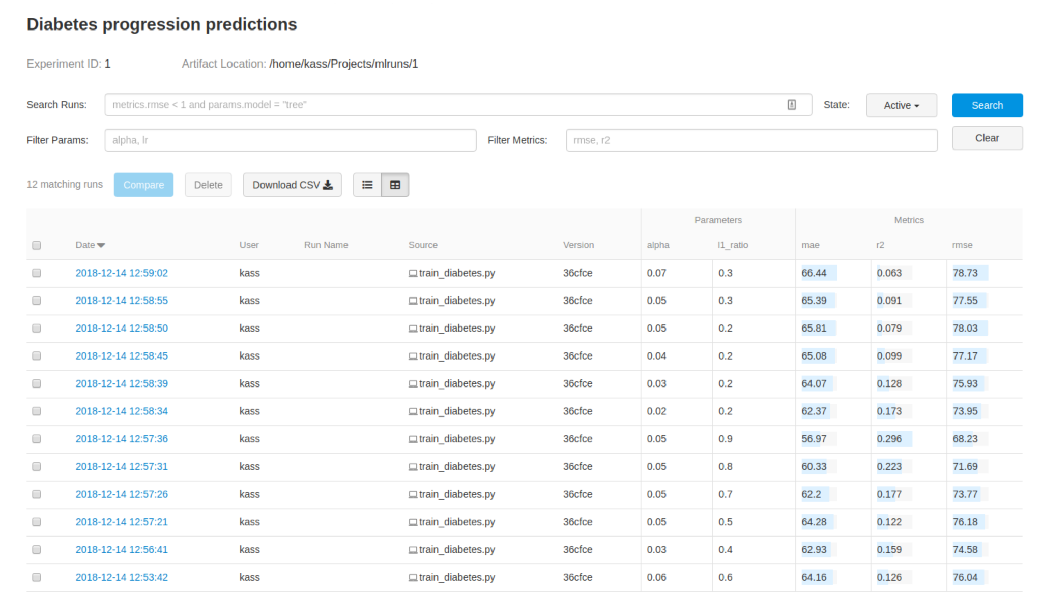
ML Flow - Tracking - UI

Slide 23
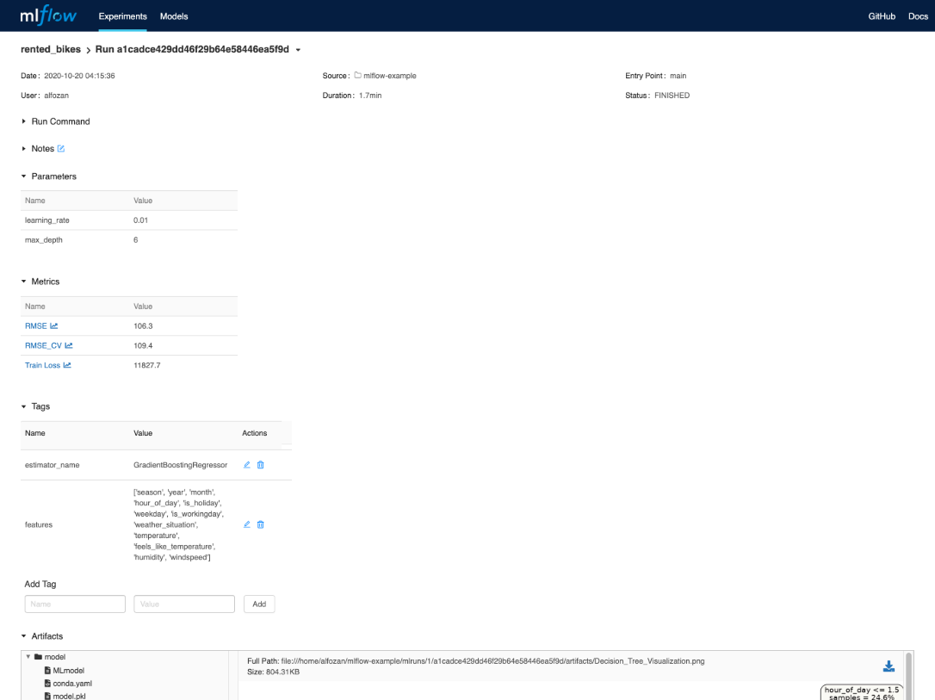
ML Flow - Tracking - UI

Slide 24
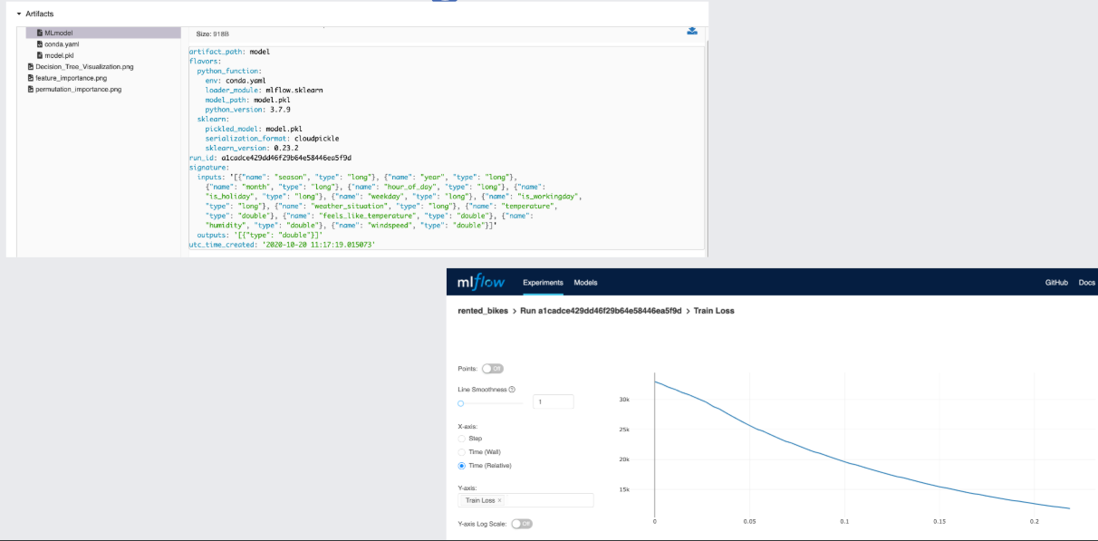
ML Flow - Tracking - UI

Slide 25
ML Flow - Projects
a format for packaging data science code in a reusable and reproducible way, based primarily on conventions.
• In addition, the Projects component includes an API and command-line tools for running projects, making it possible to chain together projects into workflows.
https://www.mlflow.org/docs/latest/projects.html

Slide 26
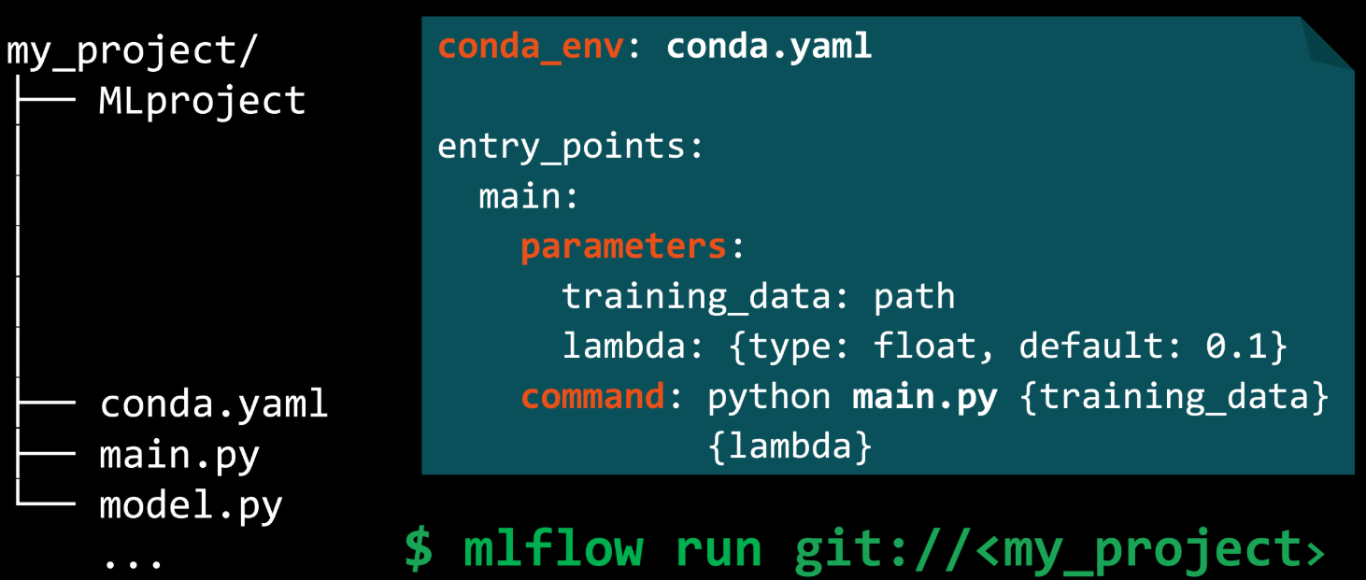

Slide 27
ML Flow - Models
a standard format for packaging machine learning models
that can be used in a variety of downstream tools—for
example, real-time serving through a REST API or batch
inference.
https://www.mlflow.org/docs/latest/models.html

Slide 28
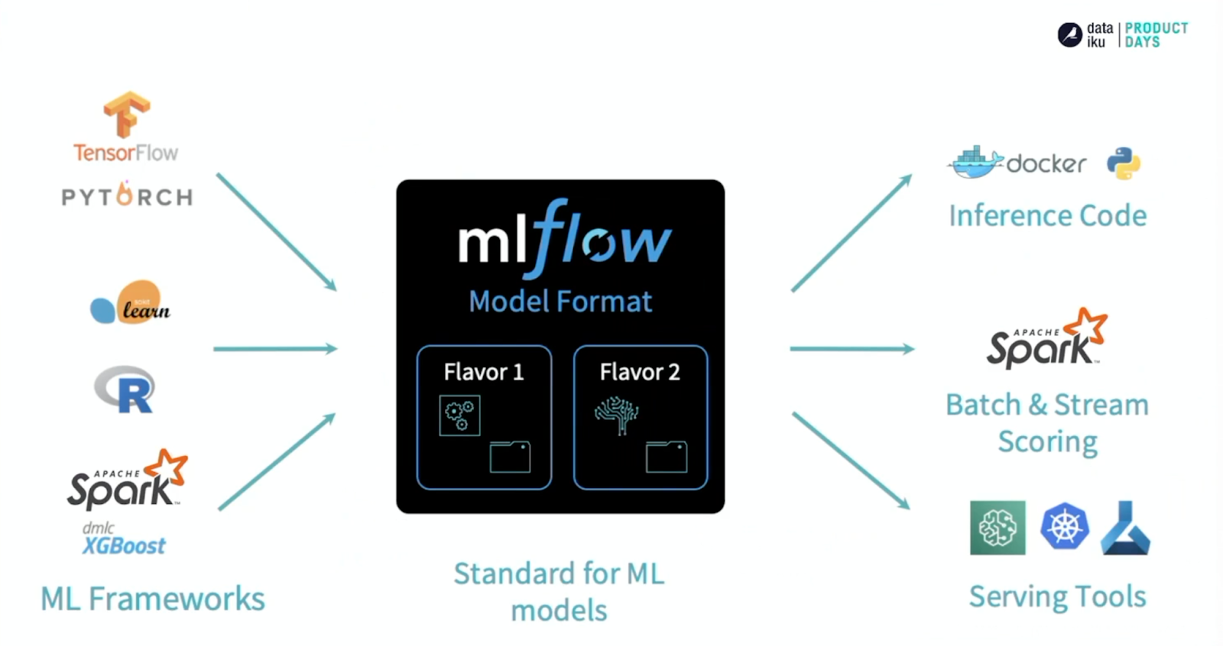

Slide 29
Q&A
Questions and answers

Slide 30
What is Hugging Face?
An open-source platform for machine learning
Fosters collaboration and innovation in the ML community
Provides a central hub for sharing, exploring, and deploying models and datasets

Slide 31
Overview of the Hugging Face Hub
A treasure trove of machine learning resources
Houses a vast collection of pre-trained models across various NLP and computer vision tasks
Offers a plethora of high-quality datasets spanning diverse domains

Slide 32
Introduction to the Hugging Face Hub
Access the Hub at https://huggingface.co/
Explore different categories like Models, Datasets, and Spaces
Leverage the search bar to find specific resources

Slide 33
Using Hugging Face Repositories
Repositories store code for models and datasets
Explore code structure and implementation details
Gain insights into model training and fine-tuning

Slide 34
Using Hugging Face Spaces
Interactive playgrounds for exploring models and datasets
Experiment with models directly on the Hub without coding
Share your Spaces with collaborators for easy access and demonstration

Slide 35
Introduction to Applied Hugging Face
Leverage pre-trained models to accelerate your projects
Fine-tune models to adapt them to your specific data and task
Build and deploy machine learning applications seamlessly

Slide 36
Using GPU Enabled Code Spaces
Access powerful GPUs for faster training and inference
Collaborate on code in real-time with teammates
Experiment with code without managing local infrastructure

Slide 37
Using the Hugging Face CLI
Hugging Face CLI (Command Line Interface) for interacting with the Hub
Install models and datasets from the command line
Manage your Hub account and activities

Slide 38
Using the Model Hub
Search for models by name, task, or author
Explore model details like description, metrics, and code
Download models for local use or experimentation in Spaces

Slide 39
Downloading Models
Download models from the Hub using the user interface or CLI
Choose the appropriate format for your project (e.g., PyTorch, TensorFlow)
Unzip the downloaded file for local use

Slide 40
Working with Models
Load downloaded models using libraries like transformers
Use models for inference tasks like text classification or question answering
Fine-tune models on your custom data for improved performance

Slide 41
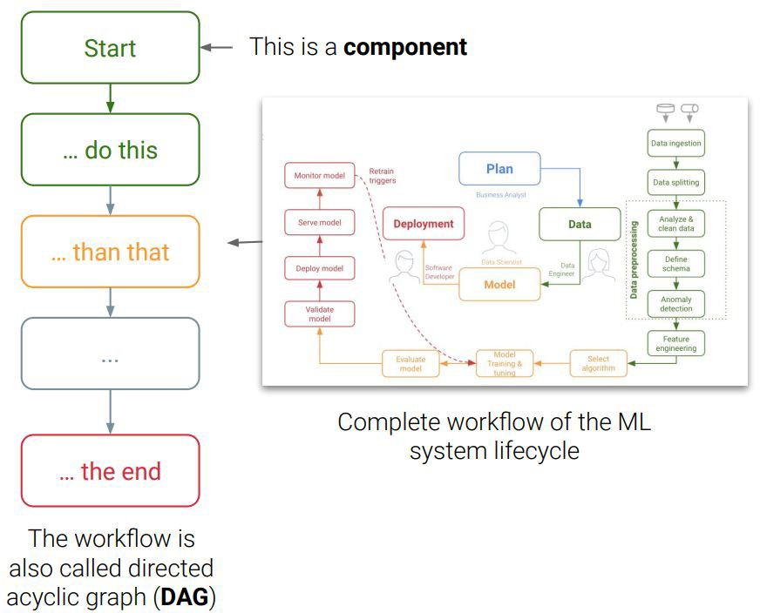
What is a pipeline?
Description of an ML workﬂow
A pipeline component is a
self-contained set of user code that performs one step in the pipeline
Includes the deﬁnition of the conﬁguration and inputs required to run the pipeline (e.g. model hyperparameters)

Slide 42
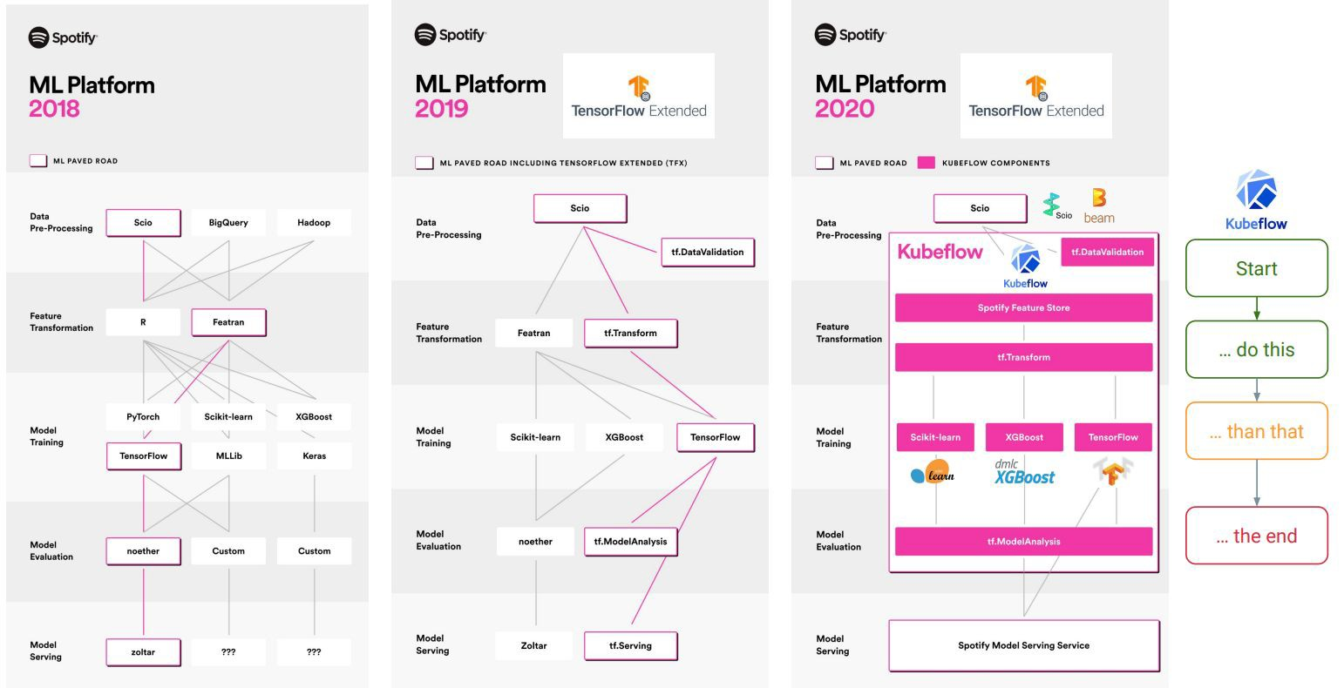

Slide 43

TensorFlow Extended (TFX)
Google-production-scale machine learning (ML) platform based on TensorFlow
Portable to multiple environments (Azure, AWS, Google Cloud, IBM, ...)
Python based toolkit; can be used with notebooks
Helps you orchestrate your ML process: Apache Airﬂow, Apache Beam or Kubeﬂow pipelines

Slide 44
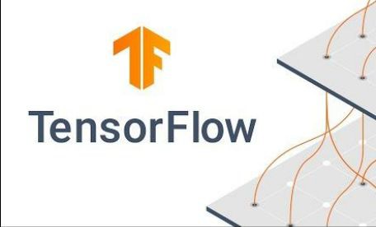
TFX 1.0 (19.05.21)
Enterprise-grade support
Security patches and select bug ﬁxes for up to three years
Guaranteed API & Artifact backward compatibility

Slide 45
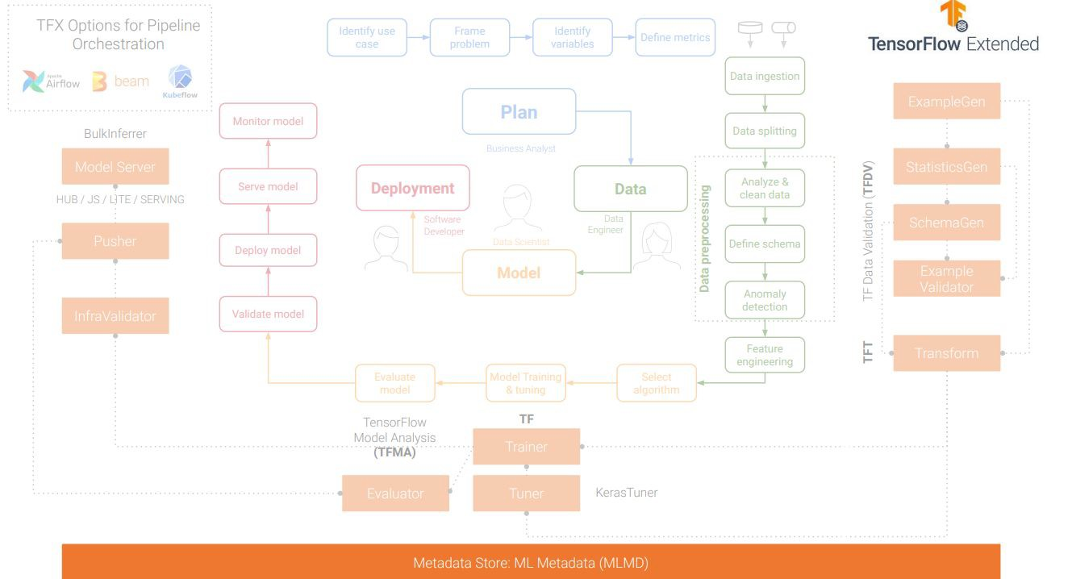

Slide 46
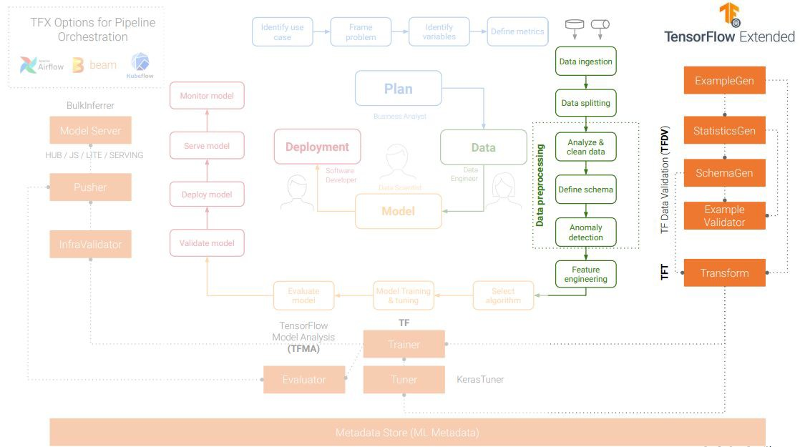

Slide 47
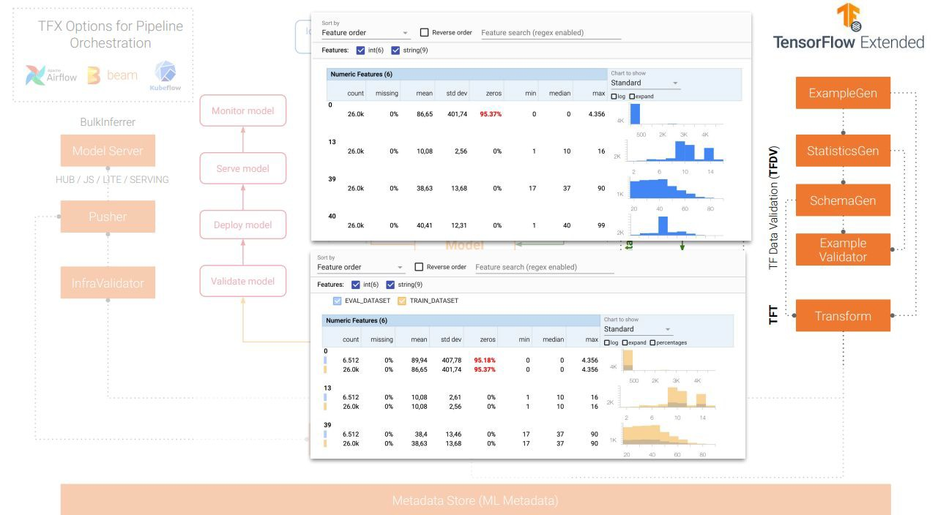

Slide 48
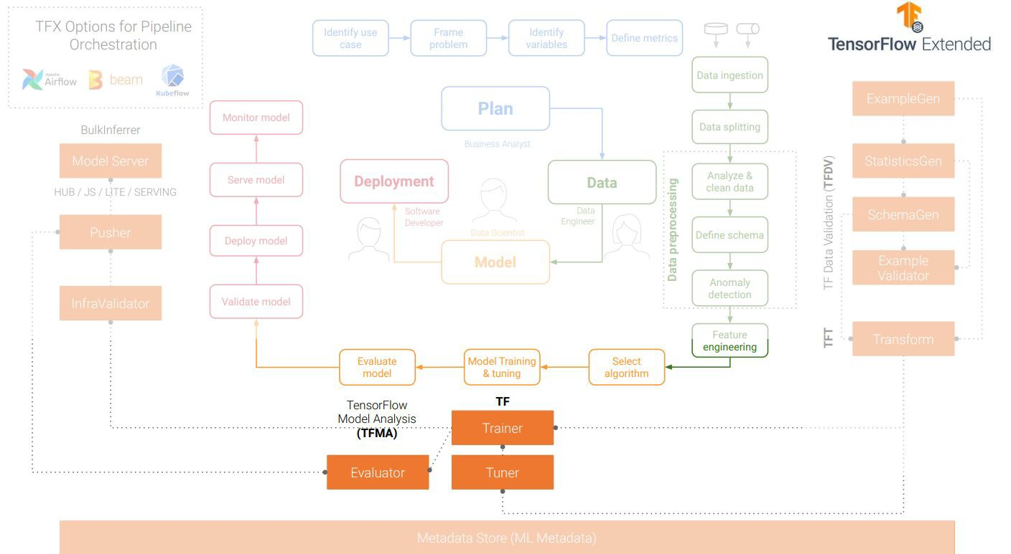

Slide 49
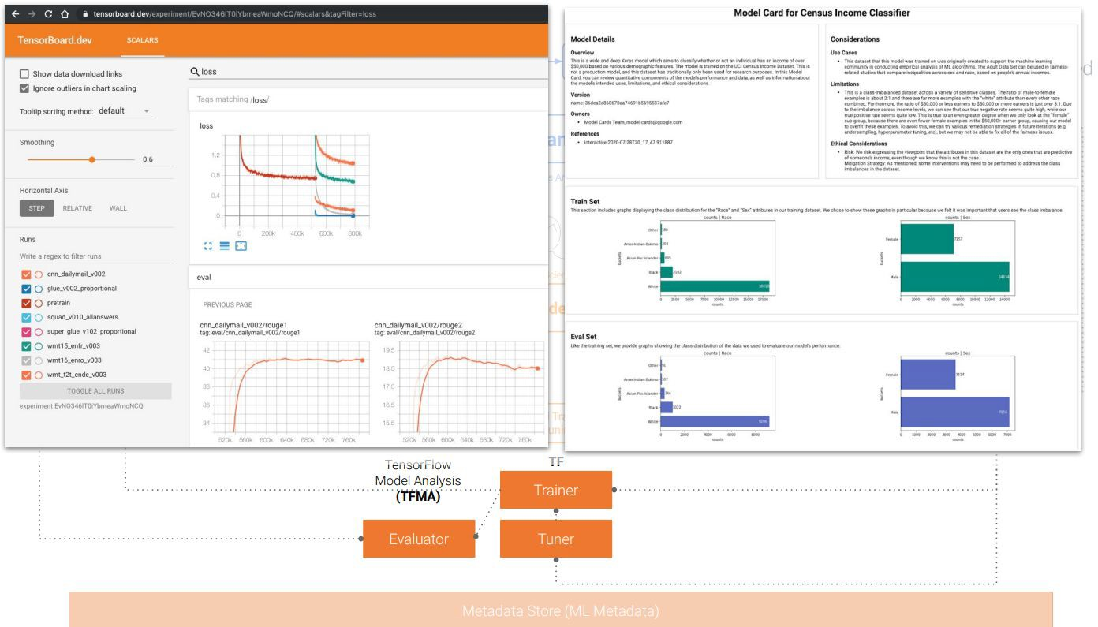

Slide 50
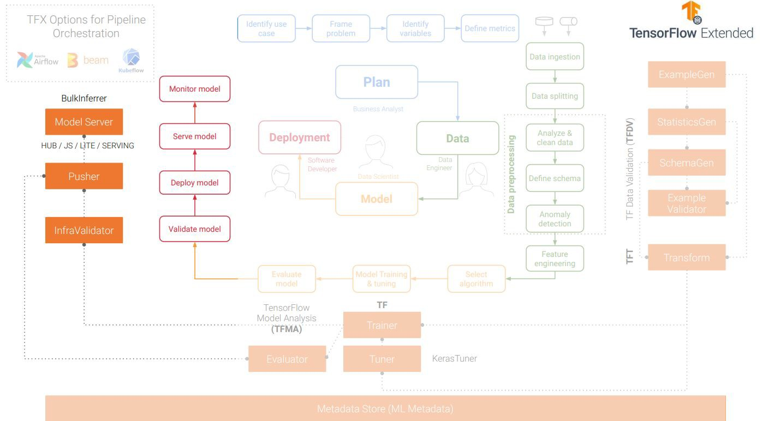

Slide 51
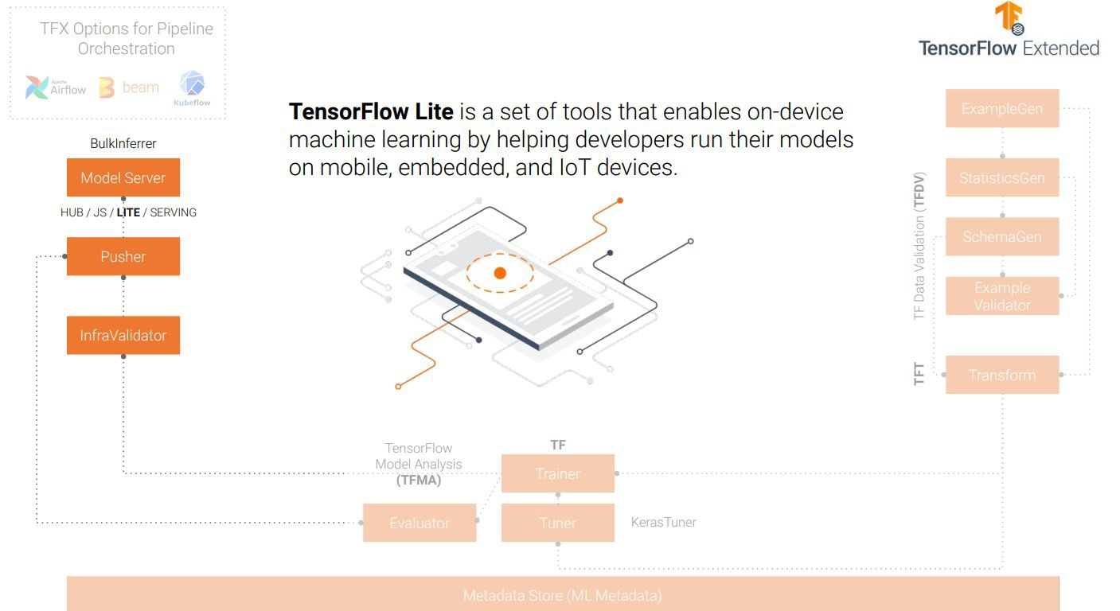

Slide 52
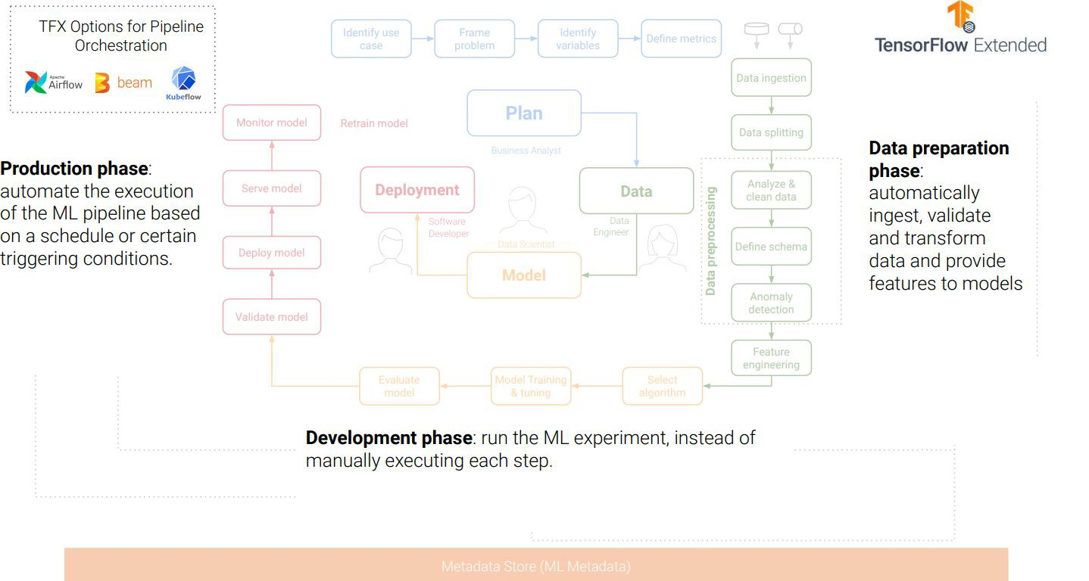

Slide 53
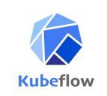


Pipeline orchestration

Slide 54
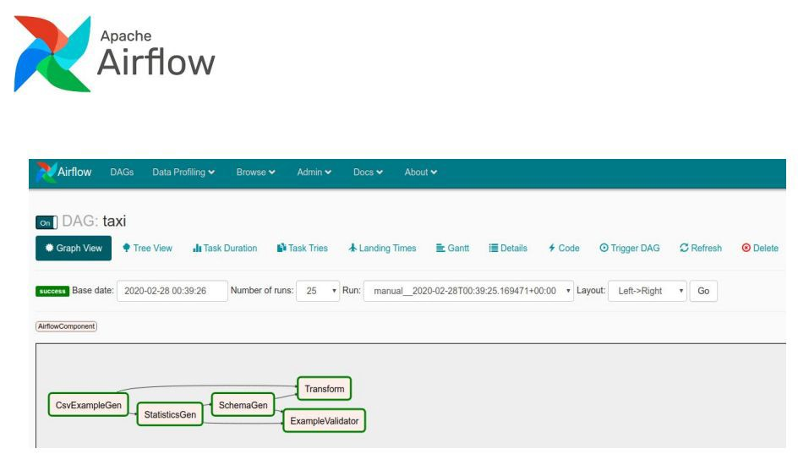
TFX & Apache Airﬂow
Programmatically author, schedule and monitor workﬂows with Python code
User interface to visualize pipelines running in production, monitor progress, and troubleshoot issues

Slide 55
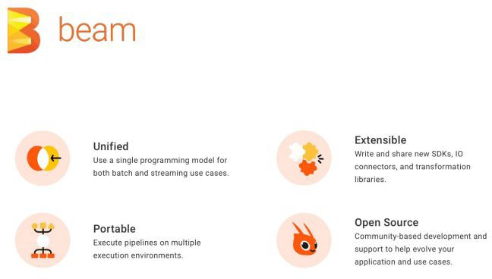
TFX & Apache Airﬂow
Provides a framework for running batch and streaming data processing jobs that run on a variety of runners (Spark, Flink, ...).
Beam provides an abstraction layer which enables TFX to run on any supported runner without code modiﬁcations
TFX only uses the Beam Python API

Slide 56
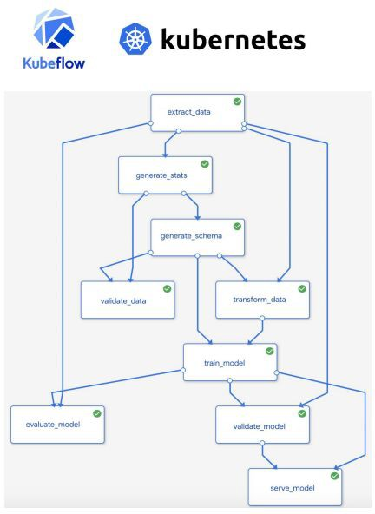
TFX & Kubeﬂow pipelines
The Kubeﬂow Pipelines platform consists of:
An engine for scheduling multi-step ML workﬂows (using Kubernetes).
User interface (UI) for managing and tracking experiments, jobs, and runs.
Python SDK for deﬁning and manipulating pipelines and components.
Notebooks for interacting with the system using the SDK
Kubeflow Pipelines is available as a core component of Kubeflow or as a standalone installation.

Slide 57
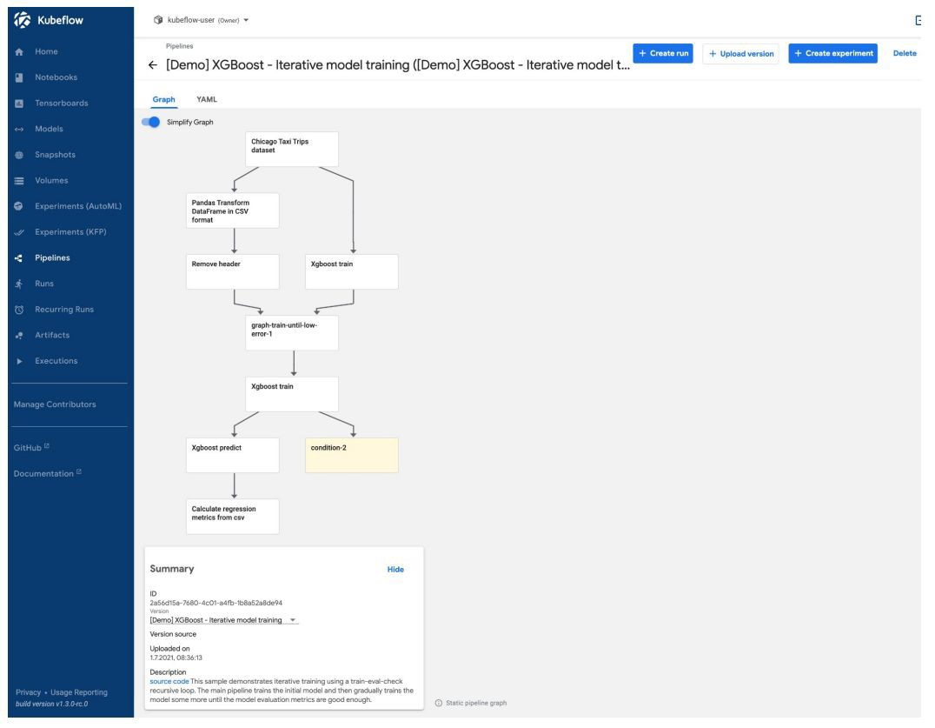

Slide 58
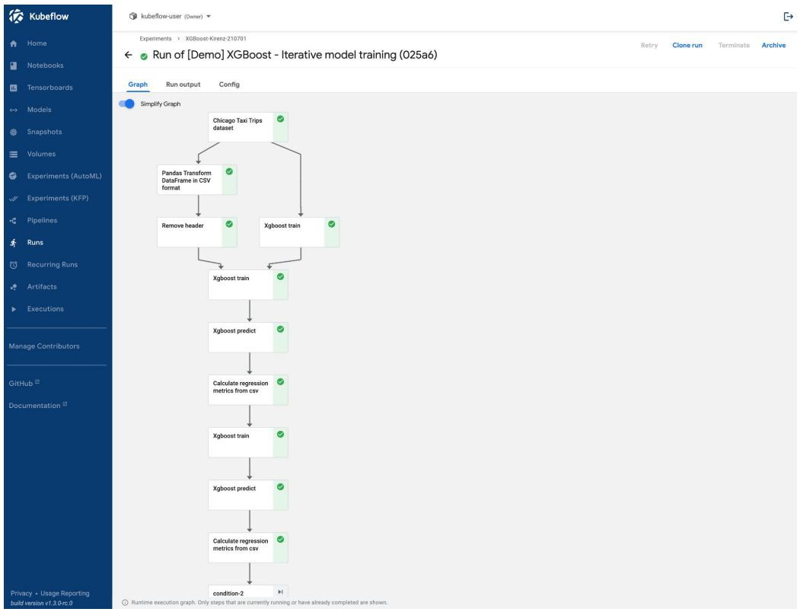

Slide 59
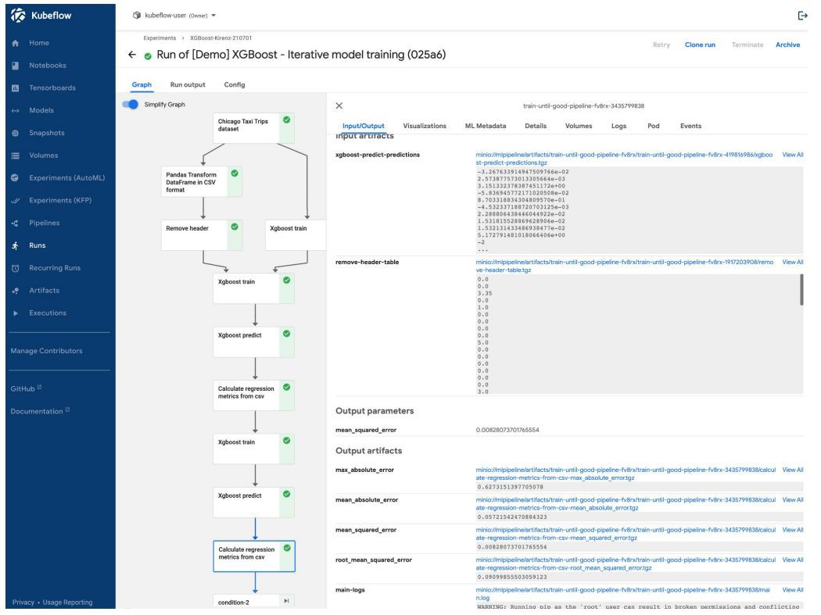

Slide 60
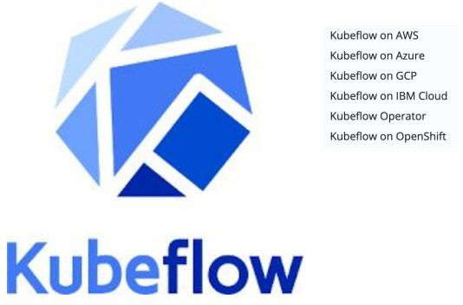

Slide 61
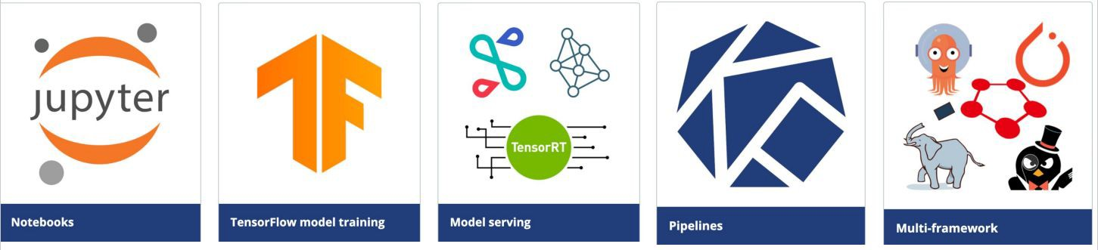
ML toolkit for Kubernetes

Slide 62
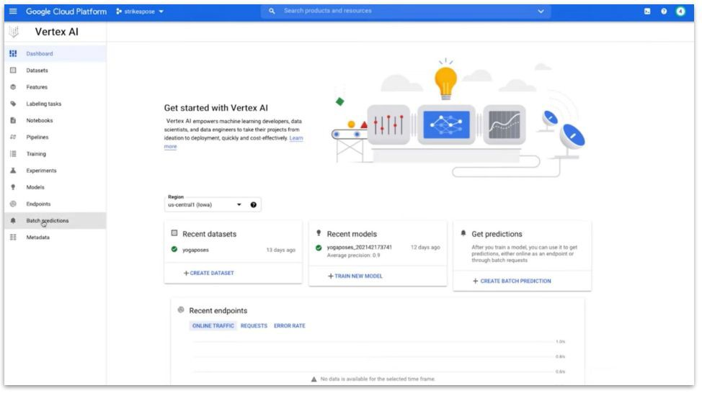

Google’s Vertex AI Launched in May 2021

Slide 63
ML Pipelines | wrap-up
To learn more visit the following tutorials @:
Data Science & Data Engineering
MLOps tutorials on how to:
Install TF and TFX
Build your first TFX pipeline
Install Kubeflow
Build your first Kubeflow pipeline
By using a ML pipeline, you can:
Automate your ML process, which lets you regularly retrain, evaluate, and deploy your model.
Utilize distributed compute resources for processing large datasets and workloads.
Increase the velocity of experimentation by running a pipeline with different sets of hyperparameters.

Slide 64

Backup
Continuous Integration and Continuous Delivery pipeline for an ML/AI project in Microsoft Azure

Slide 65
Q&A
Questions and answers

Slide 66
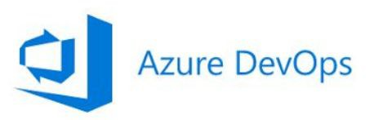
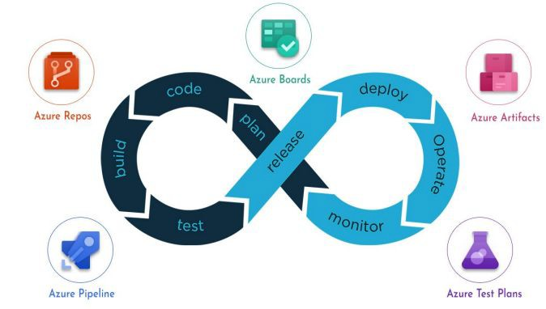
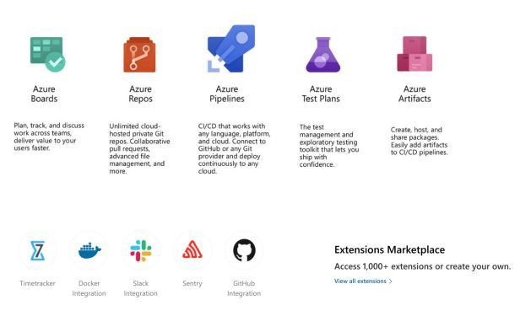
CI/CD and source code management

Slide 67
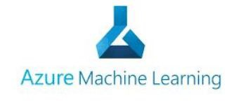
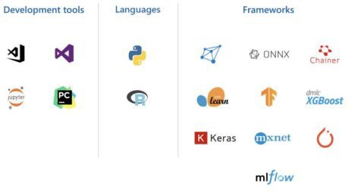
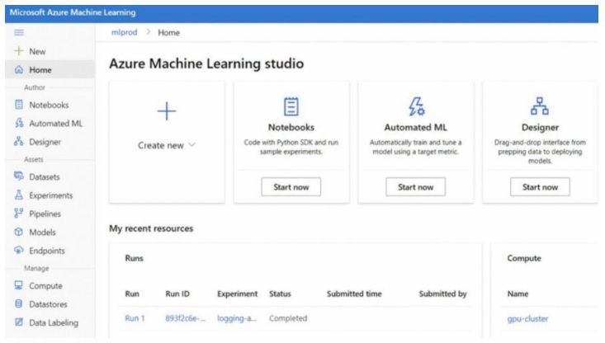
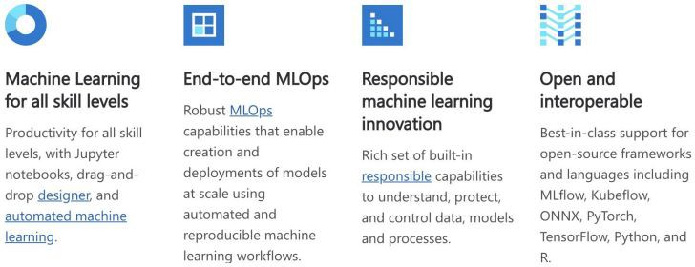
Cloud based machine learning service

Slide 68
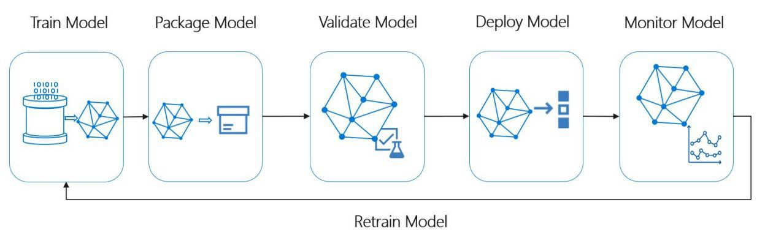

Slide 69
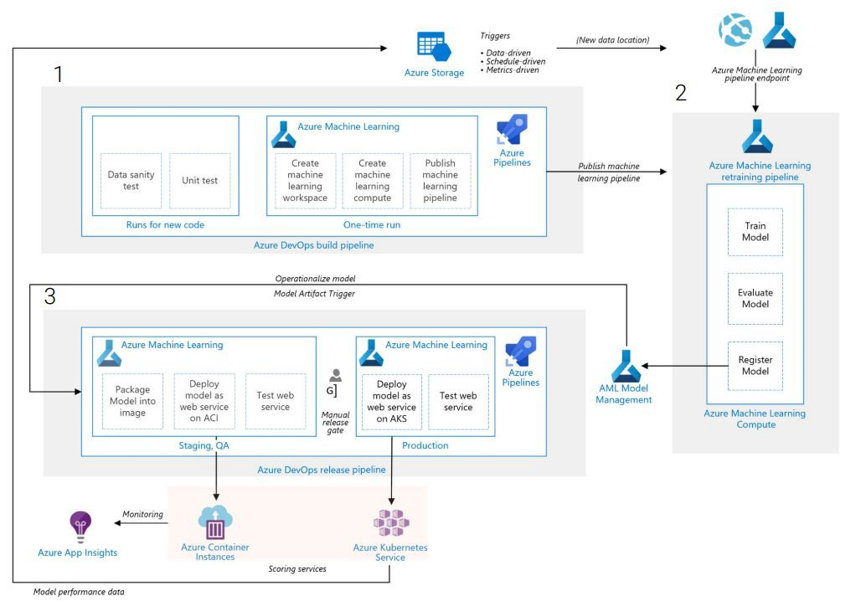

Slide 70
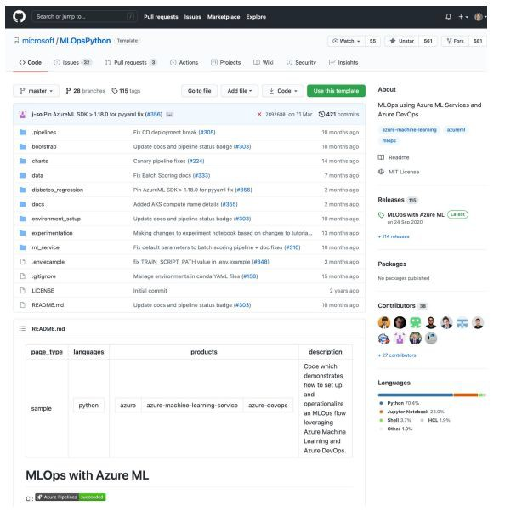
MLOps using Azure ML Services and Azure DevOps

Slide 71


Slide 72


Slide 73


Slide 74


Slide 75


Slide 76


Slide 77


Slide 78


Slide 79
Q&A
Questions and answers

Slide 80
Thanks

